Slide 1


NORTHEASTERN UNIVERSITY
DAMG 7275 ADVANCED DATABASE MGT SYS
URBAN MOBILITY DATA MANAGEMENT SYSTEM
Team 5
Teams Members:
1. Veenadharini Shukla (NU ID: 002704948)
2. Vikrant Satish Pawar (NU ID: 002772104)
3. Lokesh Mohan Jeswani (NU ID: 002795957)
4. Xin Shen (NU ID: 002728429)
5. Zequn Cao (NU ID: 002747196)

Slide 2

Table of Contents
Objectives
Architecture Design
Entity Relationalship Diagram
Data Pipeline
Visualization
Future Plan
Q & A
PPresented by Team 5

Slide 3

OBJECTIVES
To determine high and low-traffic times by analyzing the number of passengers in taxis.
To assess and contrast the frequency of trips associated with various payment methods.
To evaluate the weekly or monthly distribution of passengers over the time.
To evaluate the performance of service providers using diverse metrics.
To monitor the processing of payments and uphold a record of transactions.
To identify the most and least congested areas for taxi pickups and drop-offs.
To identify the maximum and minimum trip distances between various locations
Presented by Team 5

Slide 4
Data Dictionary
Service Provider: A diverse array of taxi options ensures accessibility and convenience for individuals navigating the bustling streets of New York City.
Trip ID: A unique identifier assigned to a specific trip or journey.
Pick-up Date: The Pick-up Date refers to the date and time when a passenger is picked up for a journey,
Drop-off Date: The Drop-off Date signifies the date and time when a passenger is dropped off at their destination,
Passenger Count: It indicates the number of passengers involved in a particular trip
Trip Distance: Trip Distance represents the distance covered during a trip,
Payment Type: Payment Type specifies the method used to pay for the trip.
Tip Amount: This amount refers to the additional monetary gratuity provided by a passenger to the service provider,
Fare Amount: Fare Amount represents the total cost of the trip incurred by the passenger.
MTA Tax: MTA Tax refers to a tax imposed on taxi or rideshare fares
Presented by Team 5

Slide 5

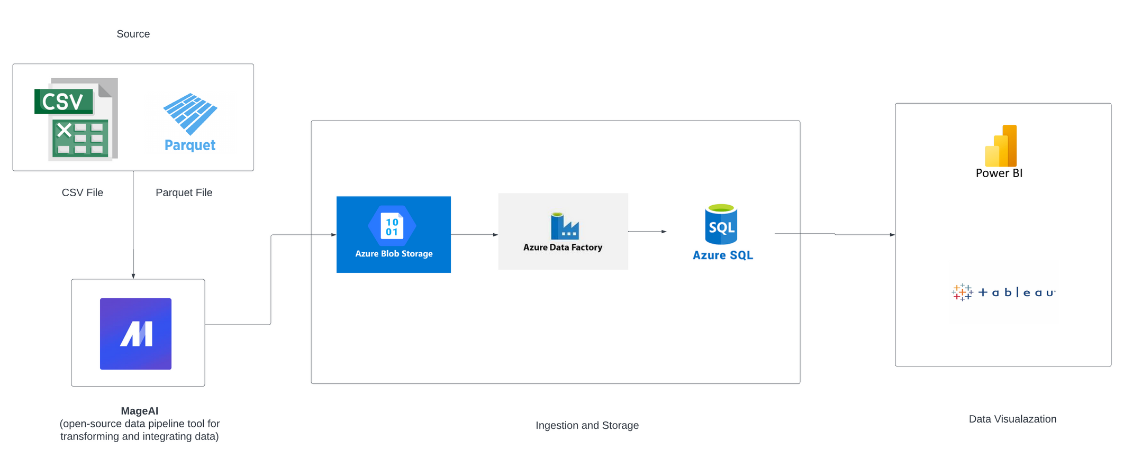
Architecture Design
PPresented by Team 5

Slide 6

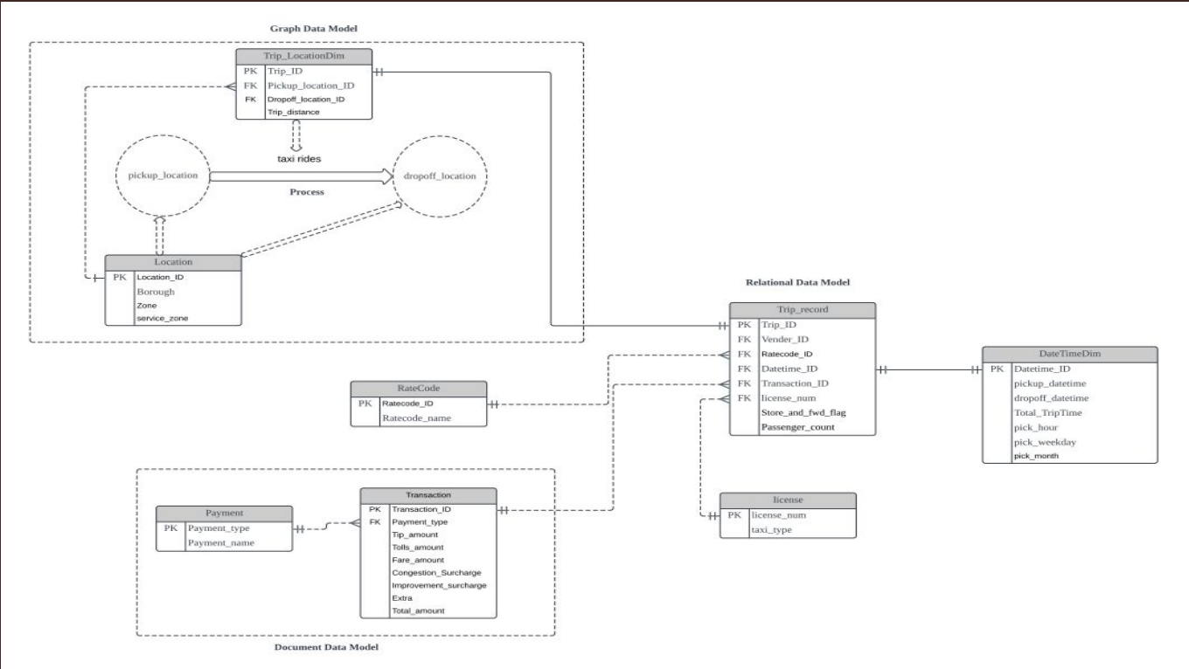
Entity Relationalship Diagram
Presented by Team 5

Slide 7




MageAI
Converting a dataset from GitHub for use in MageAI, an open-source data pipeline tool, to execute various data preprocessing steps
Export cleaned dataset
to Azure blob storage
Data Factory
Building data pipeline with dataflows and triggers to achieve data deployment and data refresh
Presented by Team 5

Slide 8
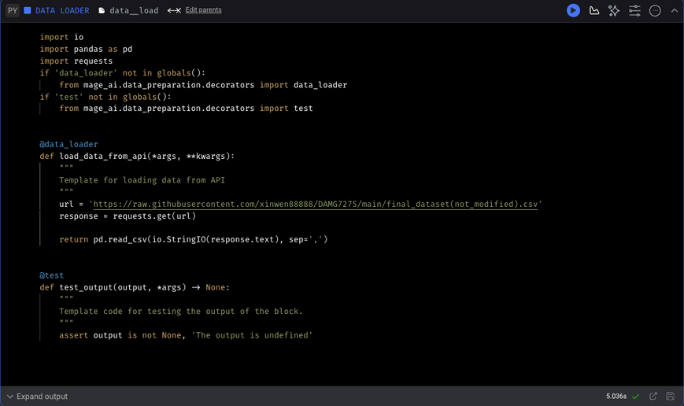
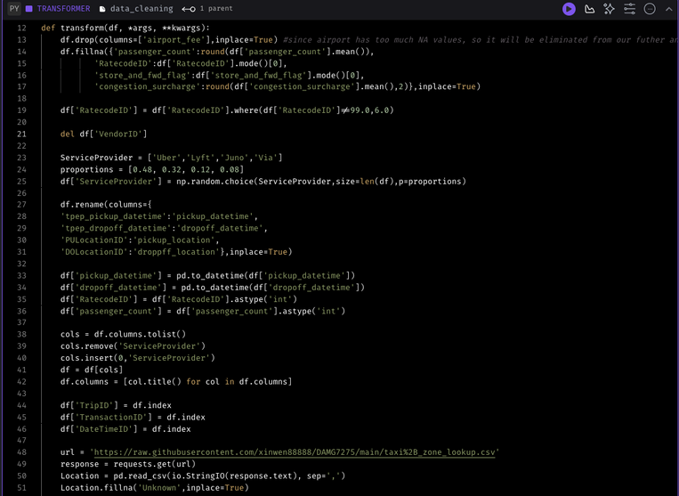
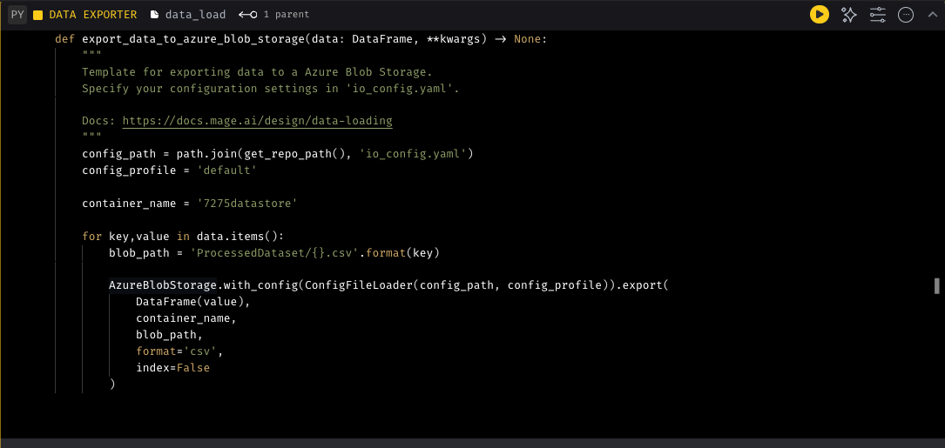
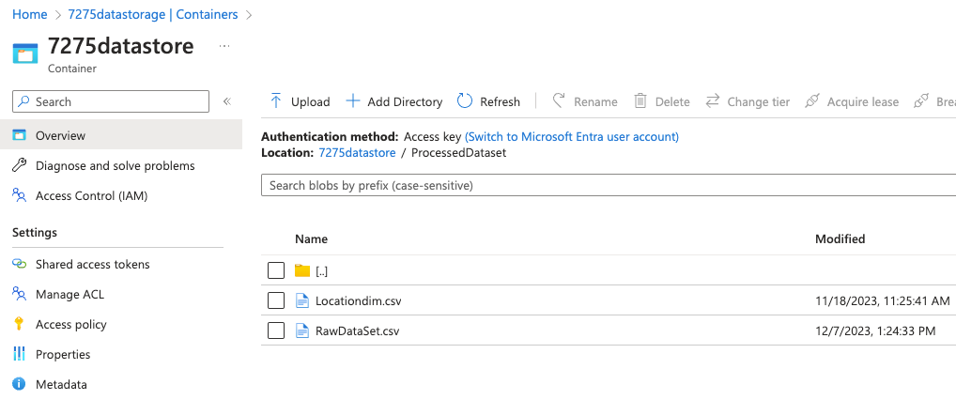
Data Load
Data Preprocessing
Data Export
the files have been transfered to blob storage
Notes:
data load: load the data from github url link
data preprocessing:
1. fill NA values
2. adjust column names into standard
3. convert data types
data export: by configuring parameters of Blob storage into MageAI, we can transfer cleaned data file from MageAI to blob storage

Slide 9
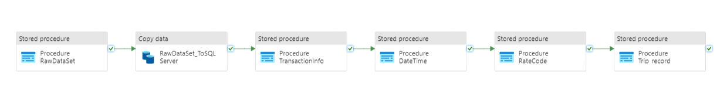

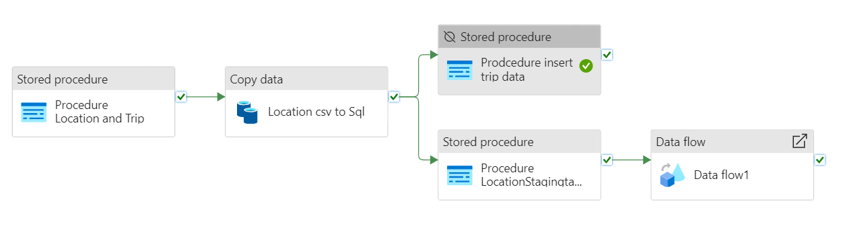
Data Pipeline
PPresented by Team 5
Notes:
the 1st pipeline: use activity of stored procedure and copy to implement table creation and data insertation
the 2nd Pipeline: We first use a stored procedure for Location and Trip and then perform the copy data activity for the Location Table. We then transfer the data in the Location Staging table using another Stored Procedure.
It is important to note that we create a staging location table because we aren't able to capture the dynamic node_id column, which always gets generated ending with a different hexcode to map to a fixed column name that can be referenced while implementing the next part in the data flow.

Slide 10
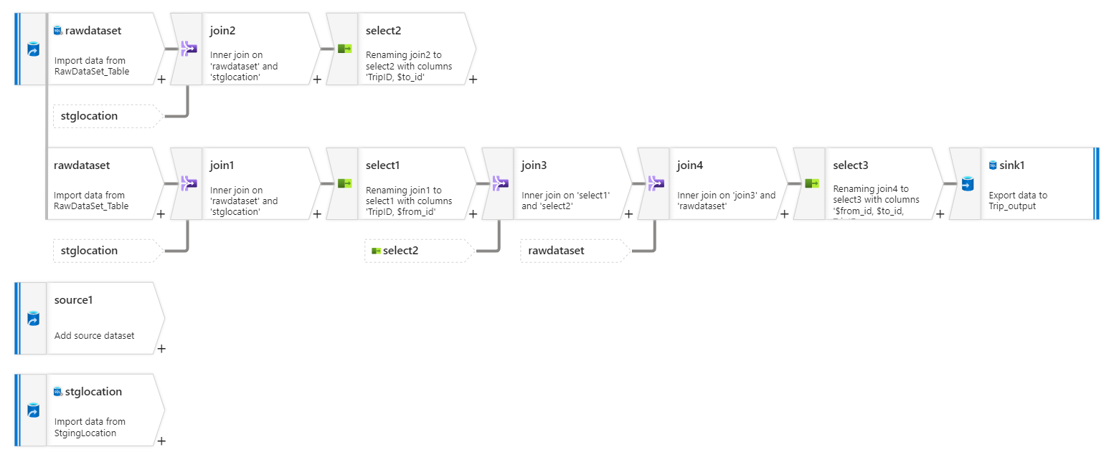
Data Flow
PPresented by Team 5
Notes:
The data flow is for loading the trip_output.
We are simply joining the pick-up and drop-off location IDs with their names and then transferring the passenger counts, trip distance, etc. attributes to the trip table.

Slide 11
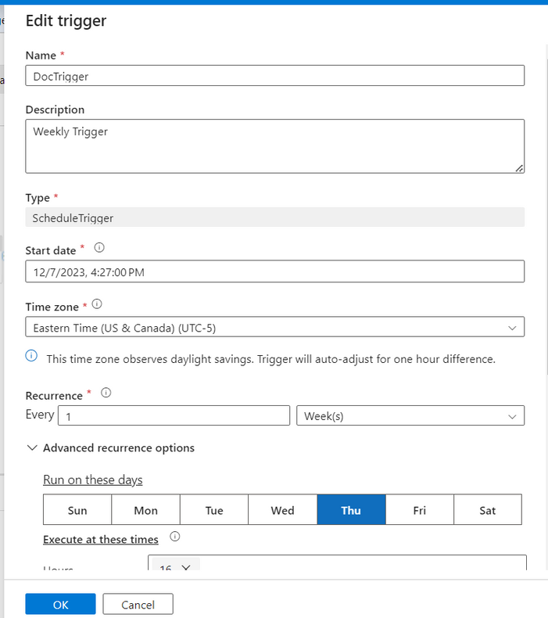
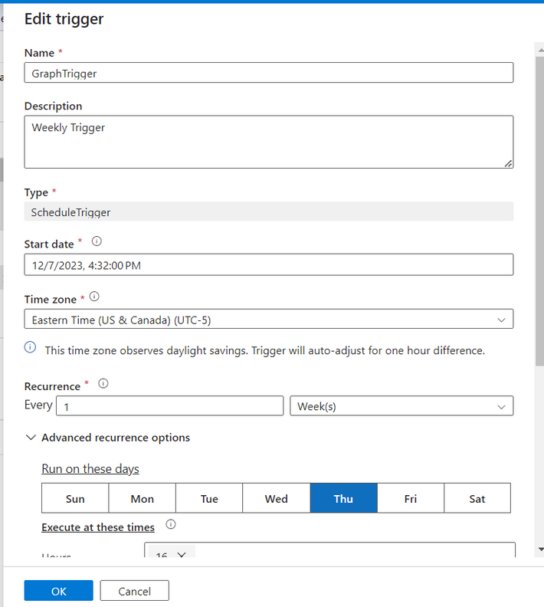
Triggers
Presented by Team 5
Notes:
Triggers play a crucial role in the overall orchestration of data workflows within Azure Data Factory, allowing you to automate and schedule the execution of pipelines based on various conditions and events.
Description: A schedule trigger starts the execution of a pipeline on a specified schedule (e.g., hourly, daily, weekly).

Slide 12
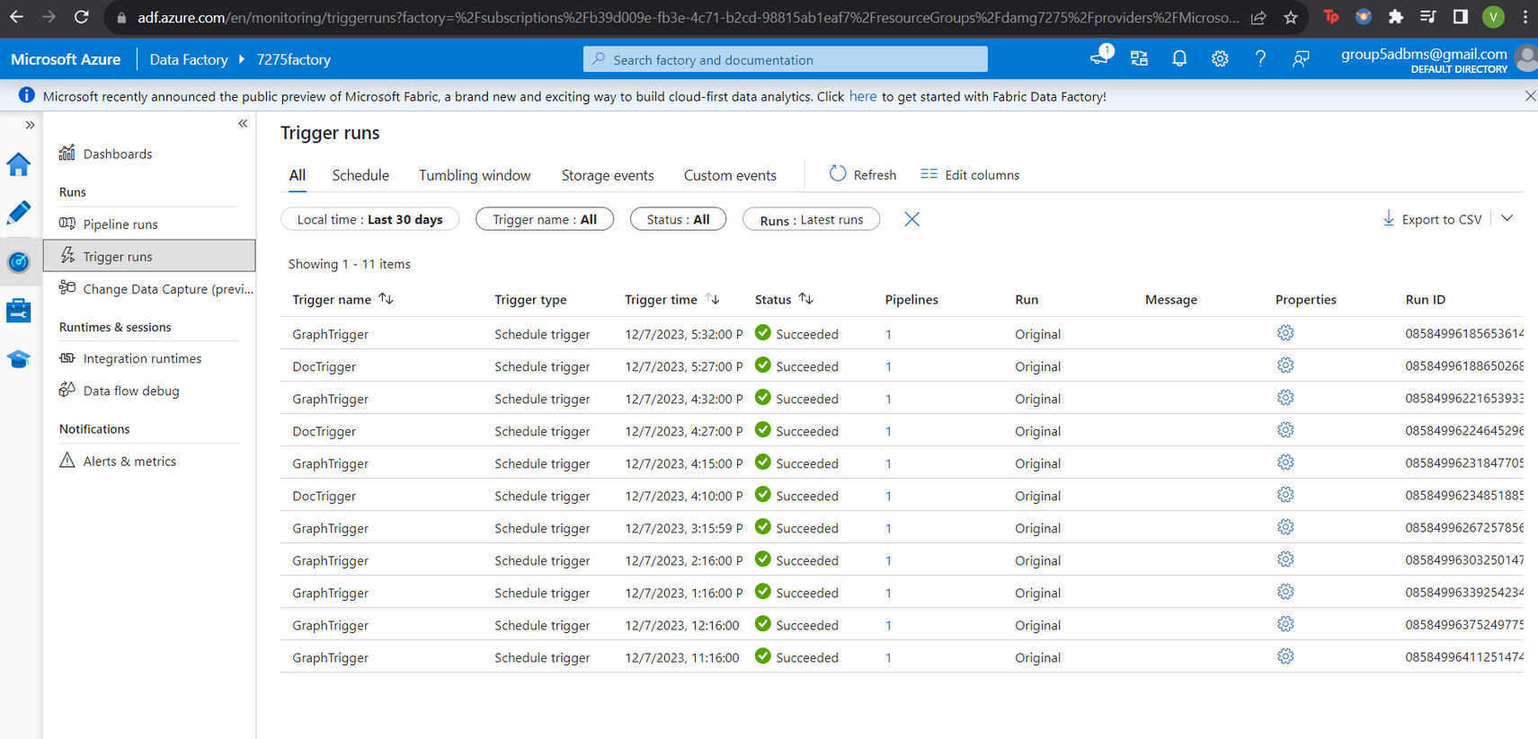
Trigger Runs
Presented by Team 5
Notes:
Utilizing Azure Data Factory's scheduled triggers to automate weekly data processing tasks, ensuring timely and efficient execution of pipelines.

Slide 13
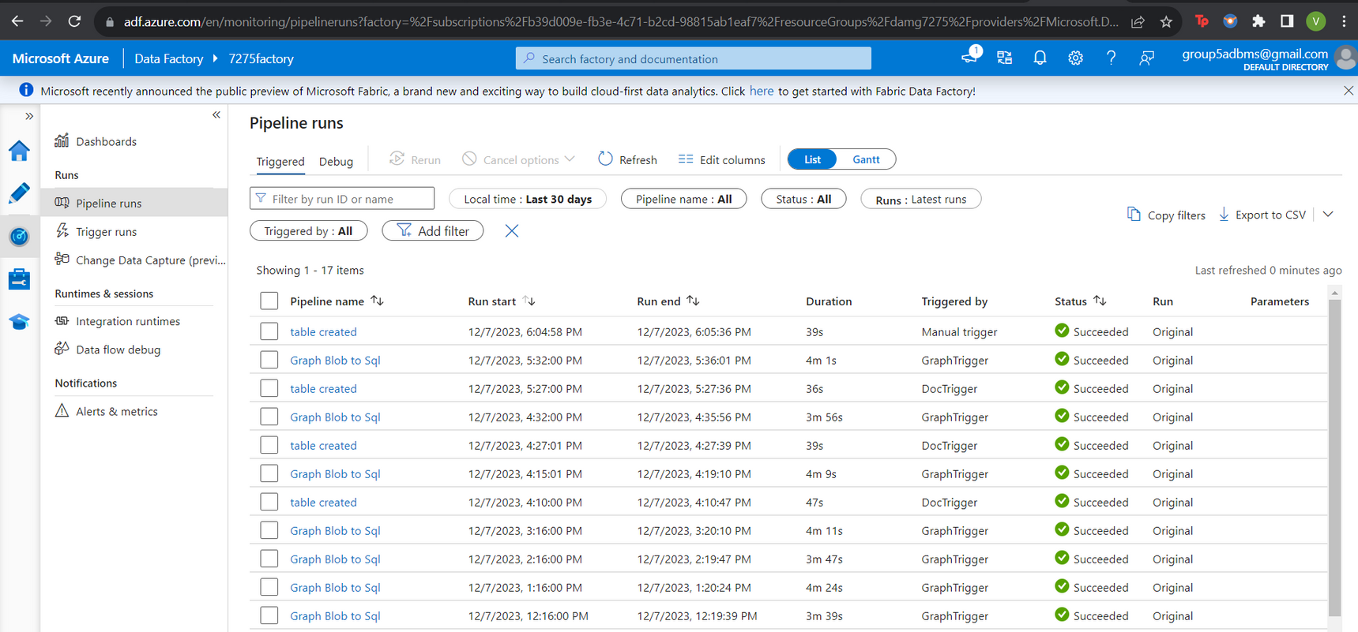
Pipeline Runs
Presented by Team 5

Slide 14


Relational Data Model Visualizations

Slide 15
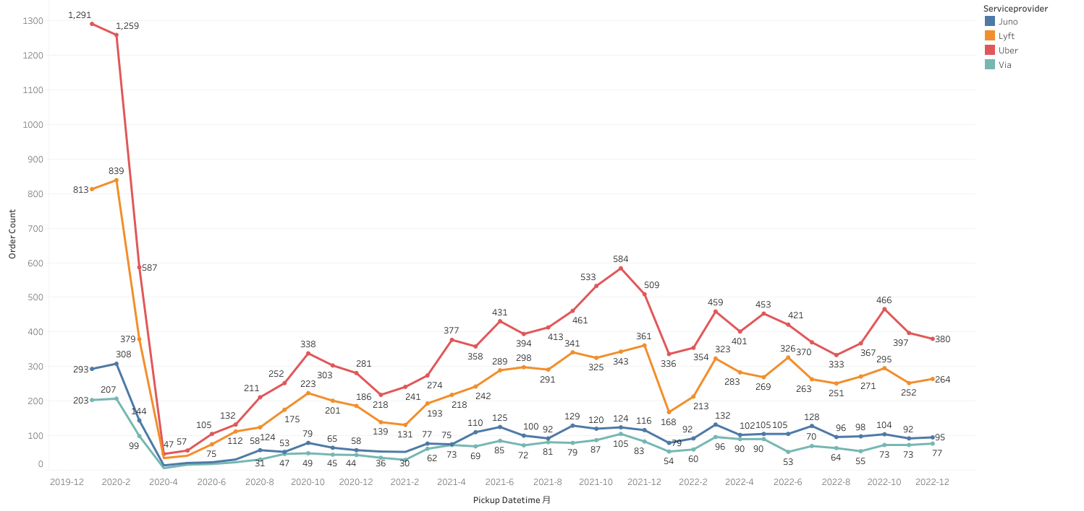
Monthly Order Count by service provider
The line chart illustrates the fluctuating order counts for service providers over three years
Presented by Team 5
Notes:
Uber's orders experienced a sharp decline at the onset of 2020, potentially due to the COVID-19 pandemic, before gradually recovering. Uber consistently maintains the highest order count among the services.There are noticeable seasonal patterns for Uber and Lyft, with peaks around late spring and early fall.

Slide 16
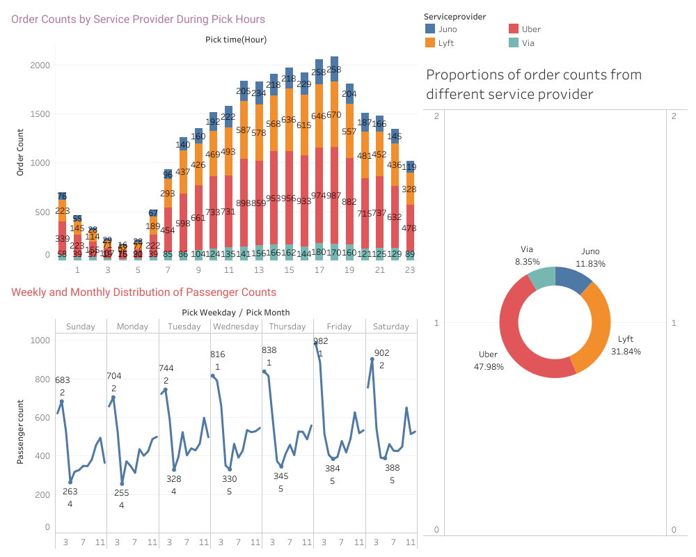
Order Count and Passenger Count Analysis
The bar chart illustrates the distribution of order counts for different service providers across various hours of the day.
The line chart displays the trend of passenger count for different weekdays and months
the pie chart shows the order ratio of 4 service providers
Presented by Team 5
Notes:
Uber consistently shows the highest number of orders throughout the peak hours, followed by Lyft. The busiest hours for all providers combined seem to be from 3 PM to 9 PM, with order counts peaking at 6 PM
Passenger demand fluctuates throughout the week, with Friday being the peak day for travel, There is also a monthly variation, with the January/ Feburary showing high passenger counts, suggesting seasonal impacts or specific events driving the demand. The lowest counts are consistently on Sundays across most months, which may reflect lower travel activity on this day.
Uber leads with approximately 48% of the orders.
Lyft follows with around 32% market share.

Slide 17
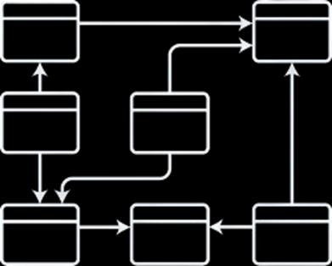
Document Data Model Visualizations

Slide 18

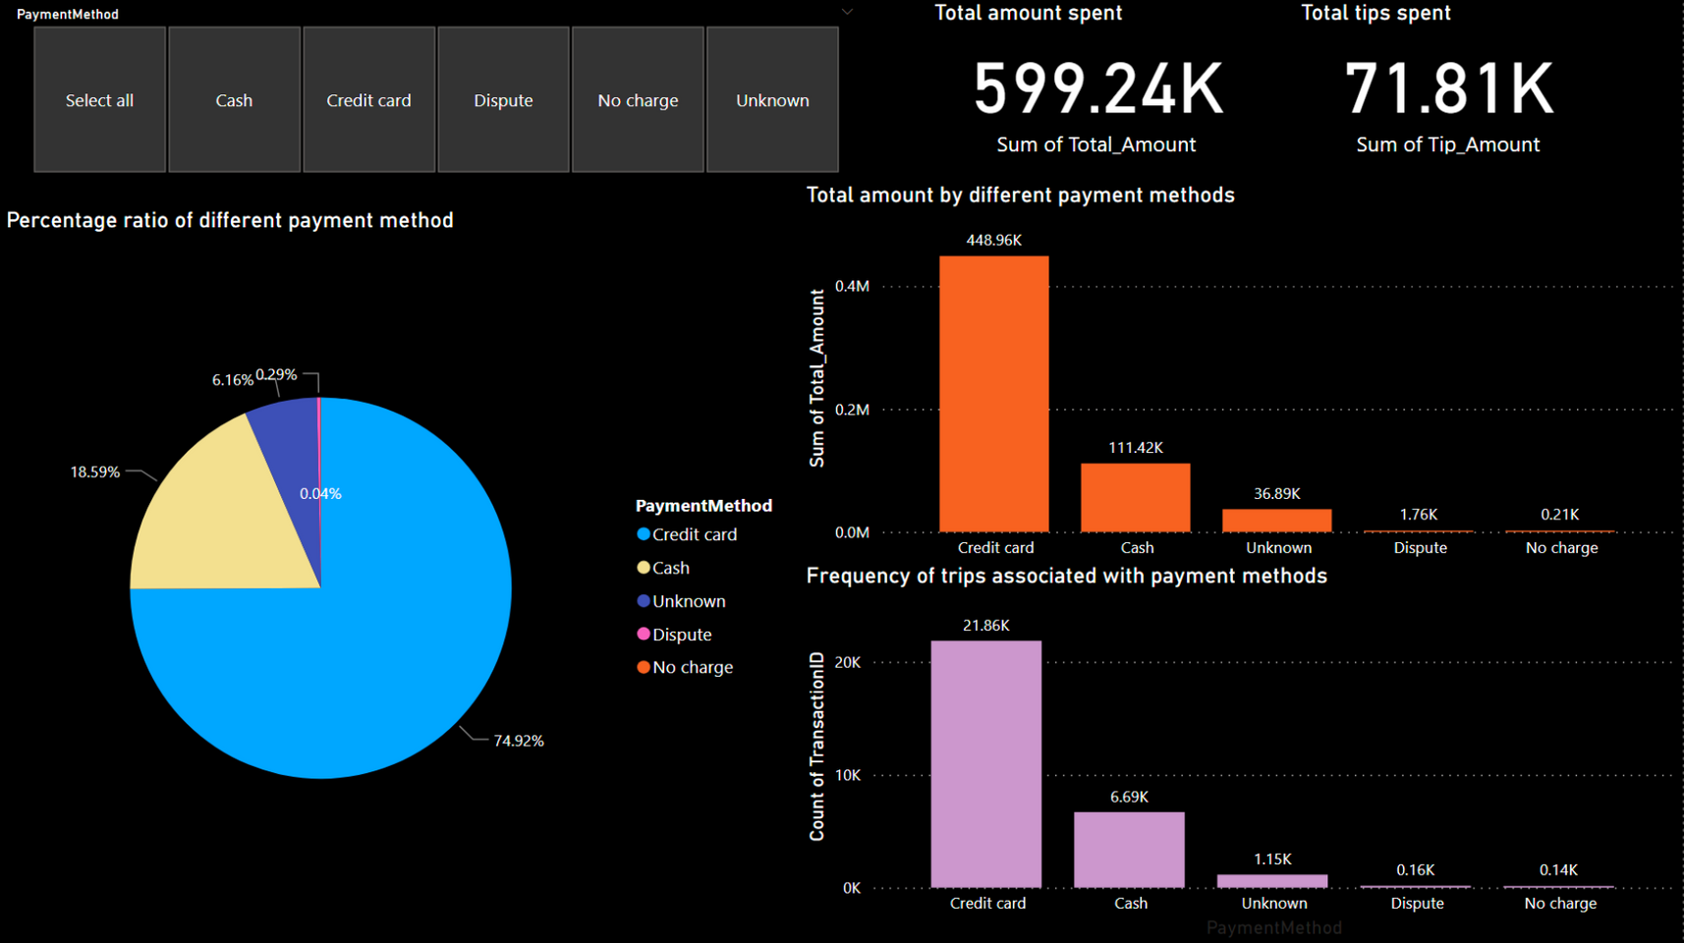
Dashboard of document part
Presented by Team 5

Slide 19
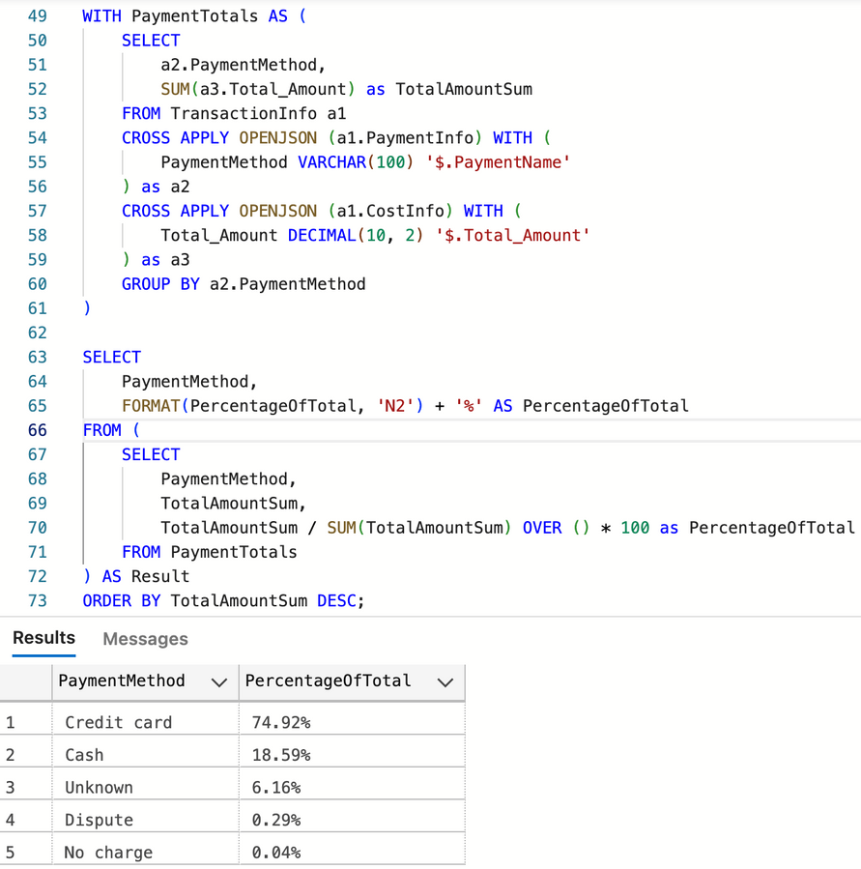
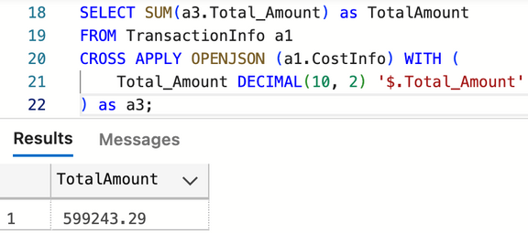
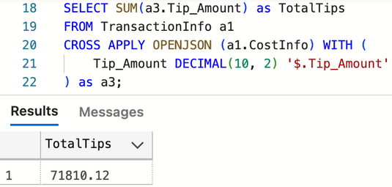
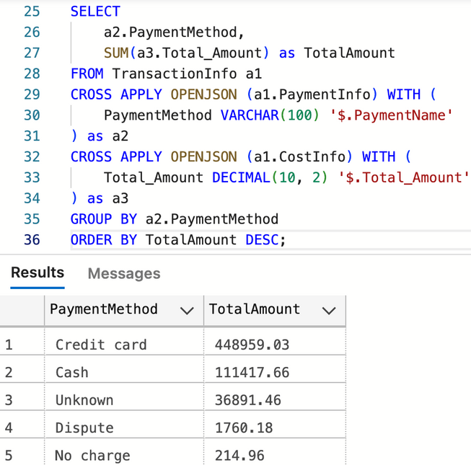
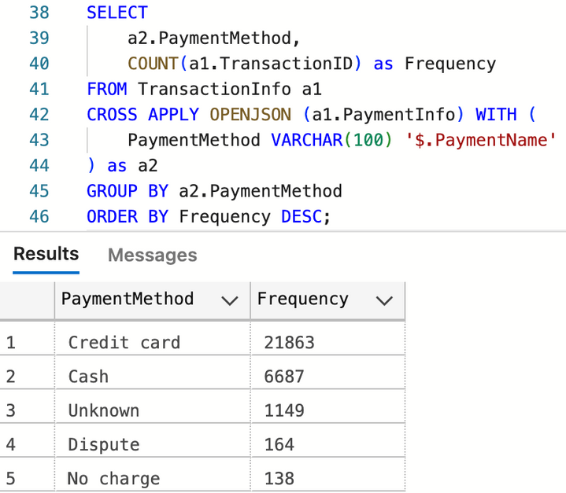
SQL Query for verification
Presented by Team 5

Slide 20

Graph Data Model Visualizations

Slide 21
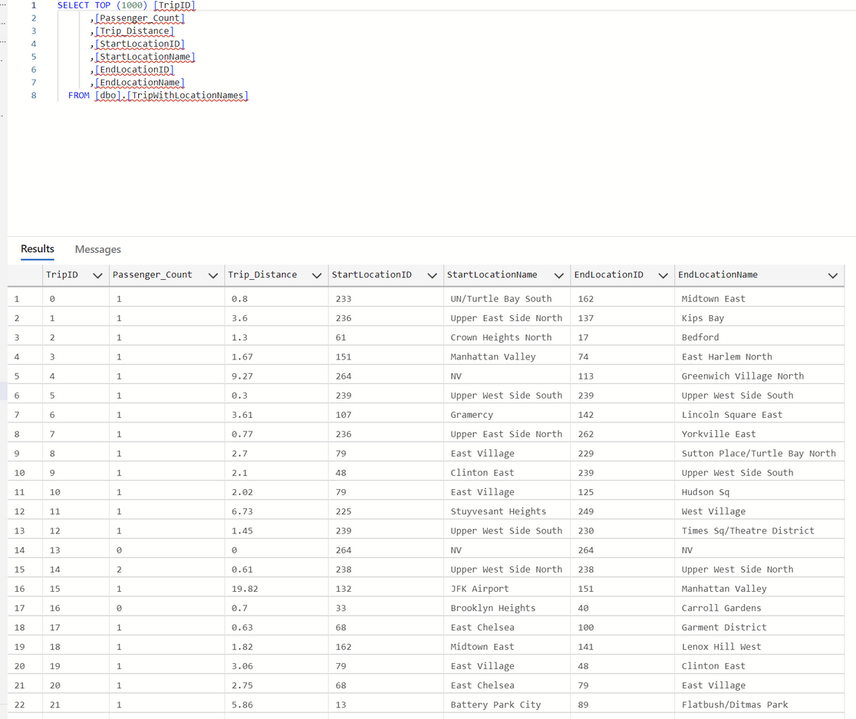
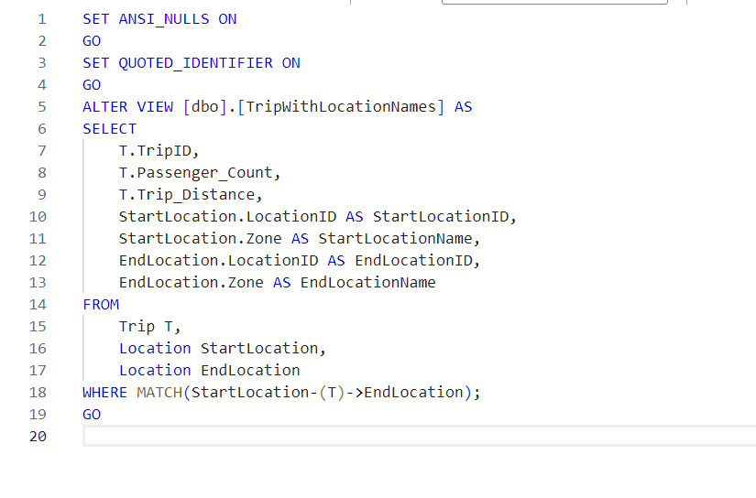
Creating a View for importing Graph Data Model into PowerBI
Presented by Team 5
Notes:
For adding the graph data model to the Power Bi, we created this view to join the pickup and dropoff location names and ids with their trip distance, trip ids and passenger counts.

Slide 22
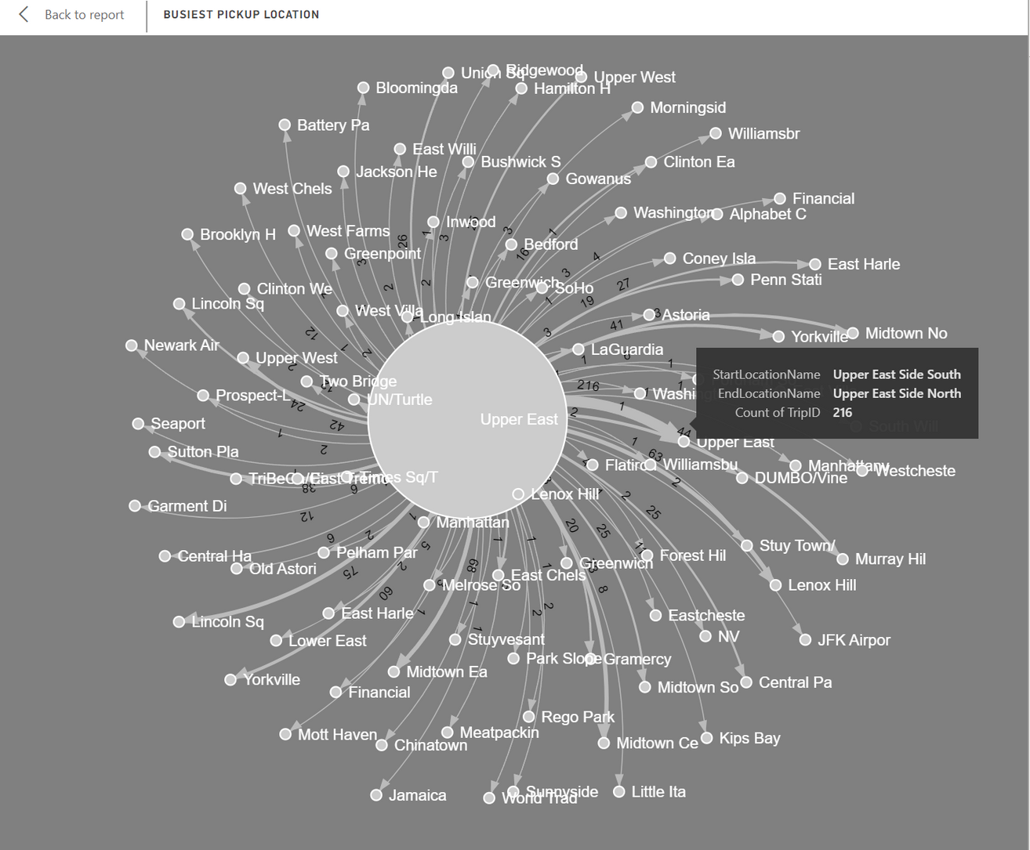
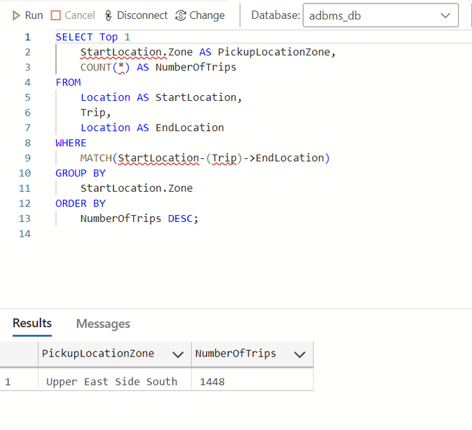
Busiest Pickup Location
Presented by Team 5
Notes:
Here we are trying to Analyze the busiest Pickup Location as a part of our Objective.
For adding
For creating this graph diagram, we have used Force Directed Graph. Here we try to filter out the

Slide 23
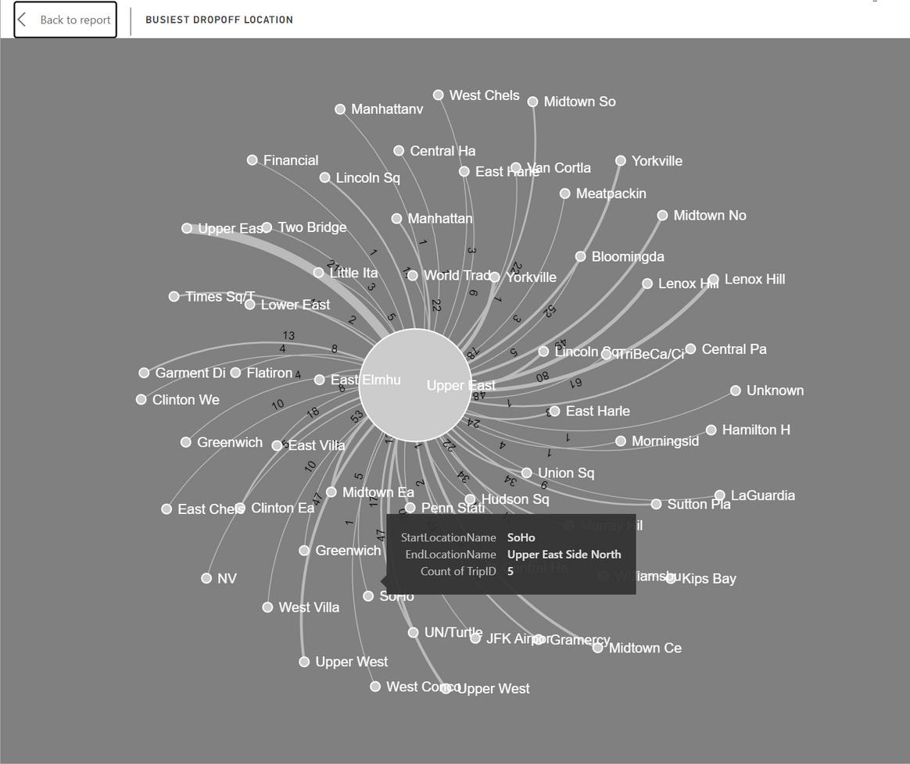
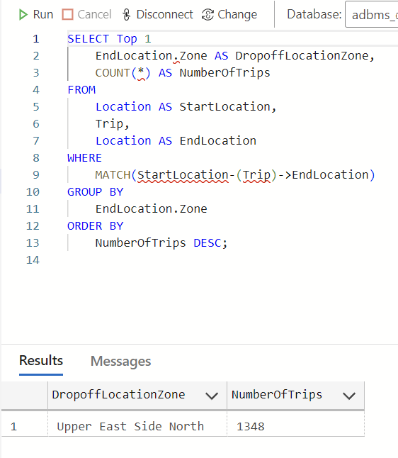
Busiest Dropoff Location
Presented by Team 5

Slide 24
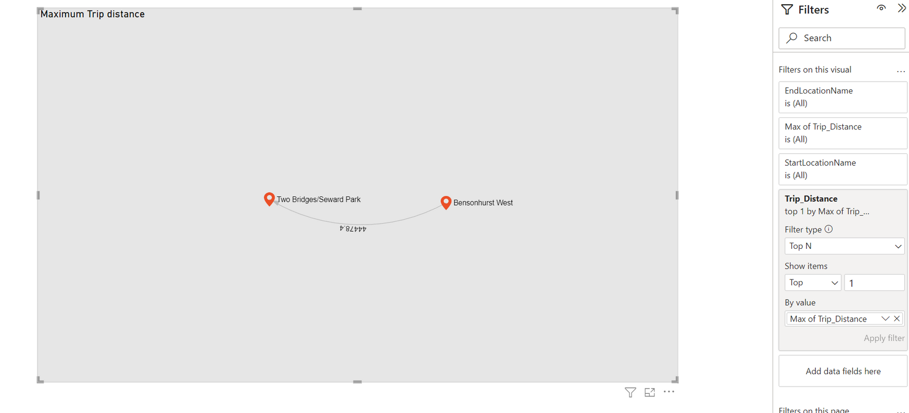
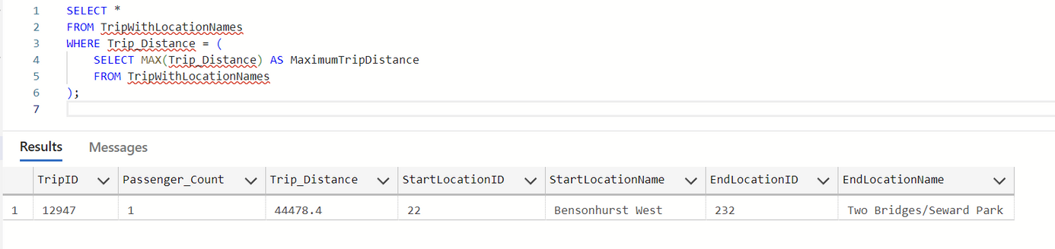
Maximum Trip Distance
Presented by Team 5

Slide 25
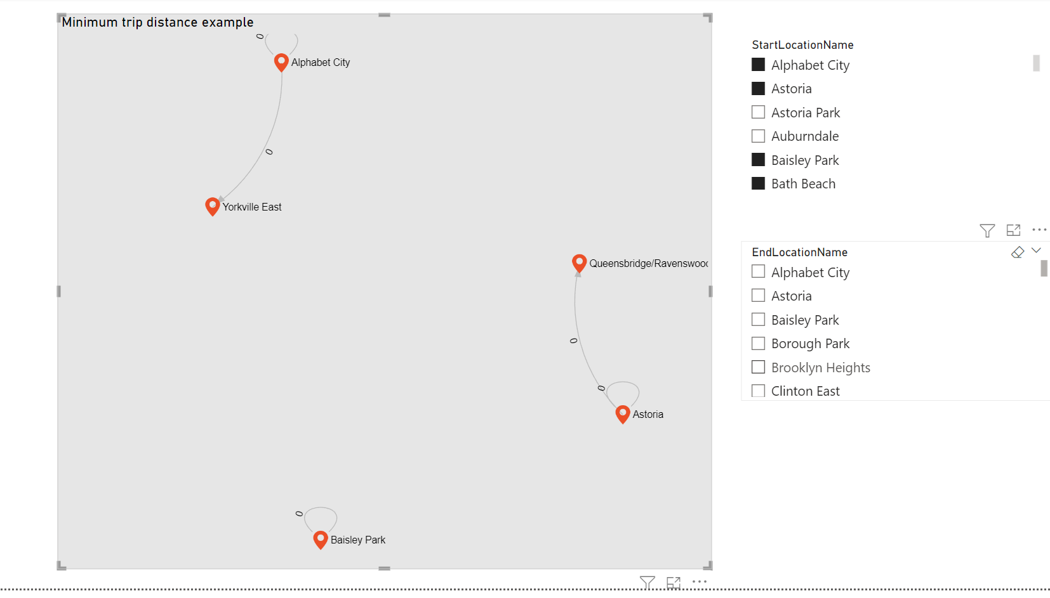
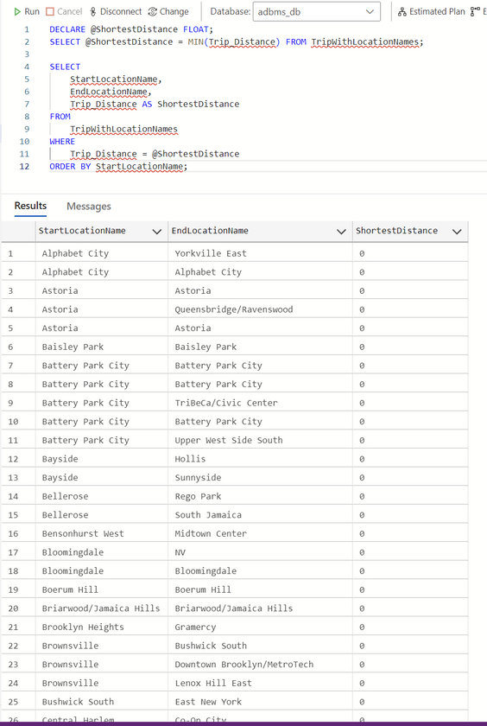
Minimum Trip Distance
Presented by Team 5

Slide 26
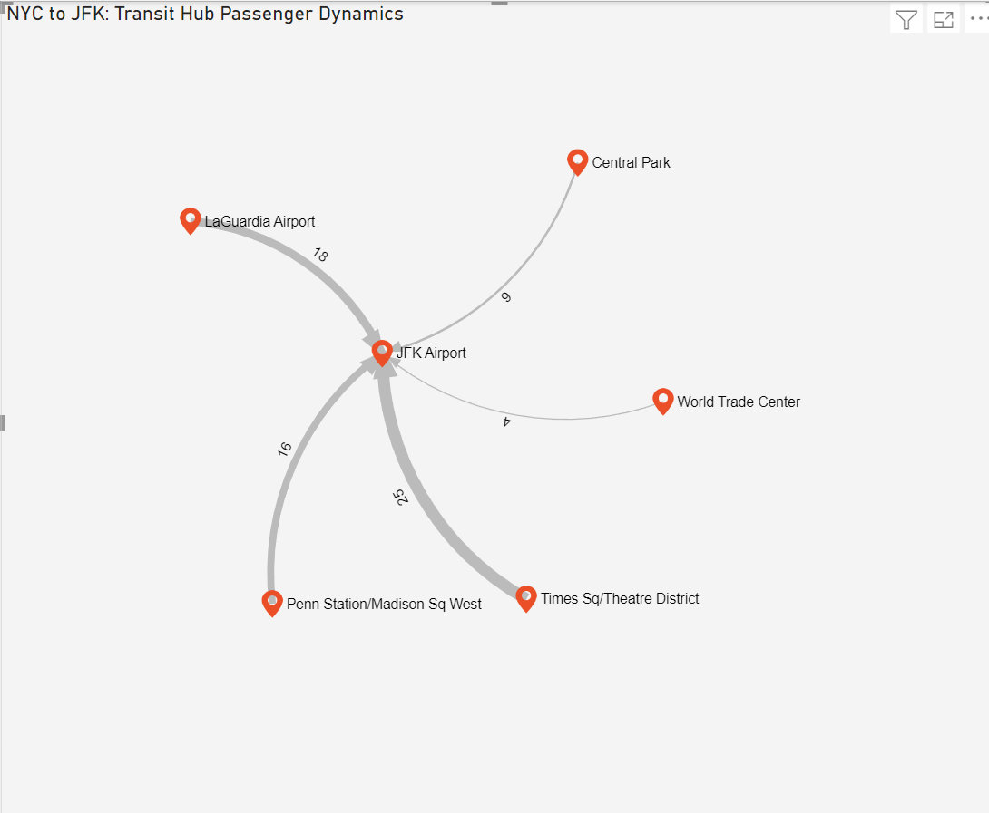
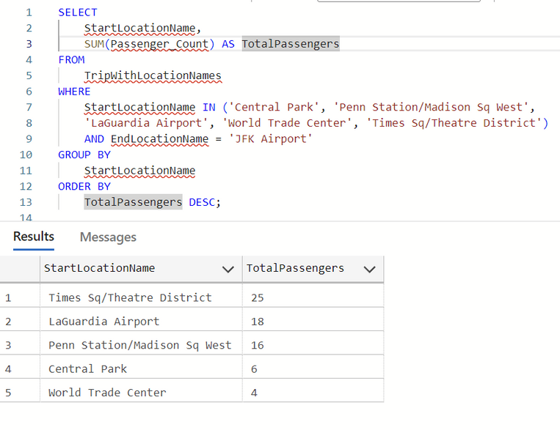
Passenger Traffic Flow to JFK Airport from Major NYC Landmarks
Presented by Team 5

Slide 27
FUTURE PLANS
Implementing real-time data processing to provide instantaneous insights into current traffic patterns, payment processing, and driver performance.
Integrate user feedback into the analysis to enhance the evaluation of driver performance and overall service quality.
Implement triggers to handle the CRUD operations and automate the pre-processing part of the project.
Explore better graph visualizations in Neo4J tool to understand traffic patterns
PPresented by Team 5

Slide 28

THANK YOU!
Any Questions?
PPresented by Team 5

